Slide 1
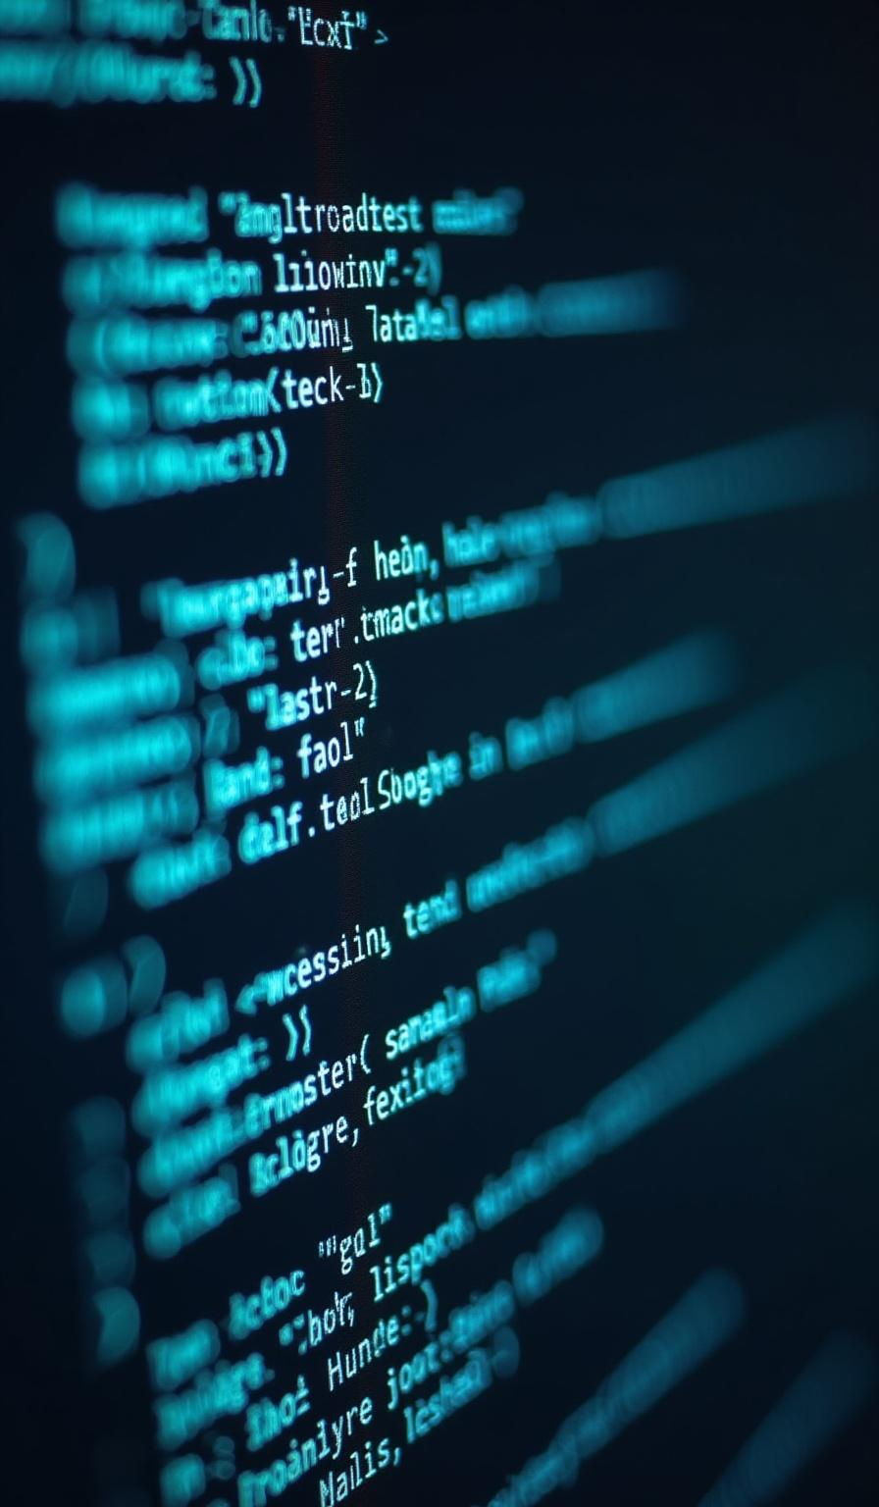
Natural Language Processing (NLP)

Slide 2

What is NLP?
NLP stands for Natural Language Processing.
It enables machines to understand, interpret, and respond to human language.
NLP combines linguistics and computer science.

Slide 3
Applications of NLP
Chatbots and Virtual Assistants (e.g., Siri, Alexa)
Spam Email Detection
Language Translation (e.g., Google Translate)
Sentiment Analysis in Reviews
Speech Recognition and Voice Commands

Slide 4
NLP Pipeline Overview
1. Sentence Segmentation
2. Word Tokenization
3. Removing Stop Words
4. Stemming and Lemmatization
5. Part of Speech (POS) Tagging
6. Dependency Parsing
7. Named Entity Recognition (NER)
8. Chunking (Shallow Parsing)

Slide 5
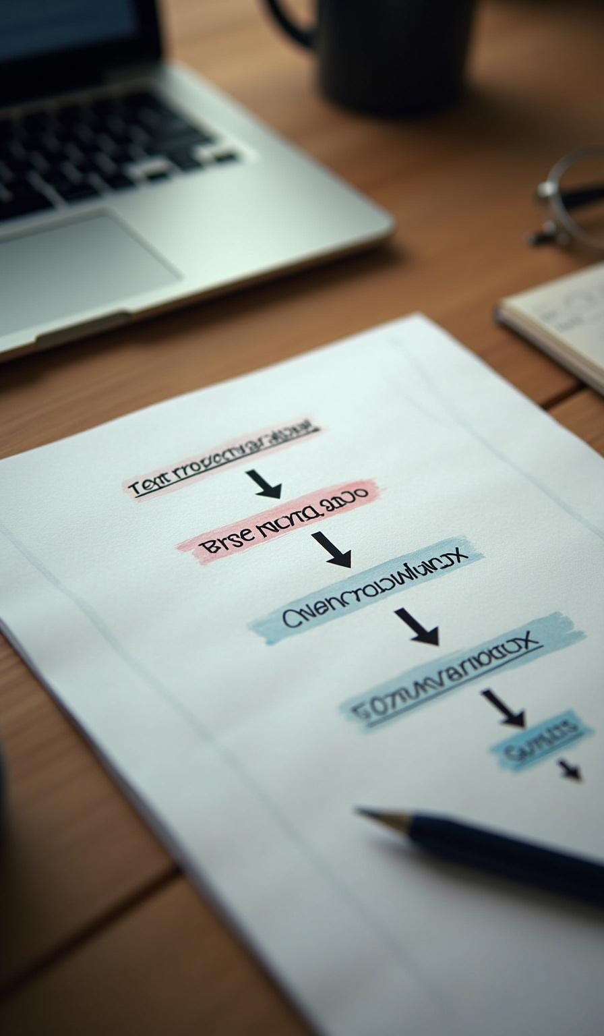
1. Sentence Segmentation
Splitting a paragraph into individual sentences. Example: 'I love NLP. It's fascinating.' → ['I love NLP.', 'It's fascinating.']

Slide 6

2. Word Tokenization
Breaking a sentence into individual words or tokens.
Example: 'I love NLP' → ['I', 'love', 'NLP']

Slide 7
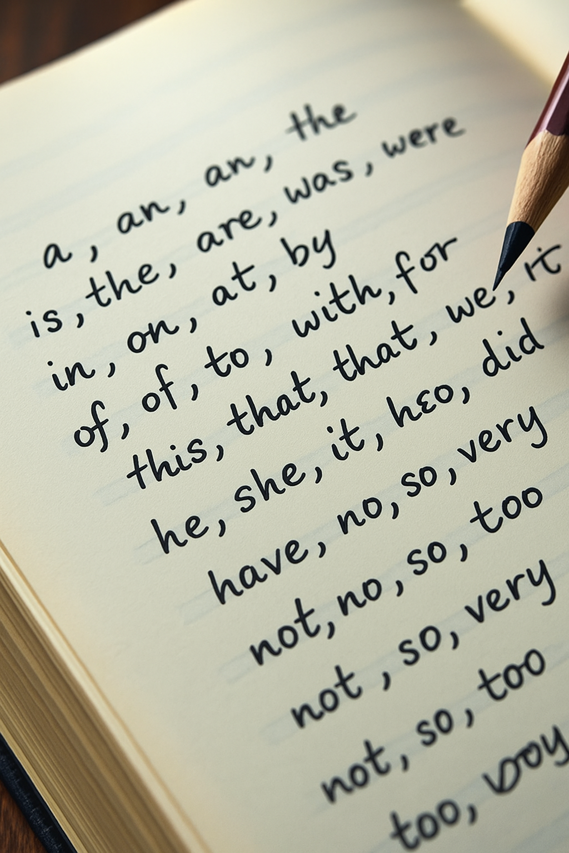
3.Stop Word Removal
Stop words are commonly used words in a language that are often filtered out in natural language processing (NLP) because they carry less meaningful information EG: is, the, on, at ,etc… Eliminating common words that add little value to analysis. Example: ['I', 'am', 'learning', 'NLP'] → ['learning', 'NLP']

Slide 8

4.Stemming and Lemmatization
What is Stemming?
Reduces a word to its root form by chopping off suffixes.
Doesn’t always return a valid word — just a base form.
Fast and rule-based, used in search engines and basic NLP.
Common stemmers: Porter, Snowball
✅ Example:
"playing", "played", "plays" → "play"
"running" → "run"
"studies" → "studi" (not a valid word)

Slide 9
What is Lemmatization?
Reduces words to their dictionary (base) form called a lemma.
Returns meaningful words using grammar rules and vocabulary.
Slower than stemming, but more accurate.
Requires knowledge of part of speech (POS) for best results.
✅ Example:
"am", "are", "is" → "be"
"better" → "good" (using POS rules)
"running" → "run"

Slide 10
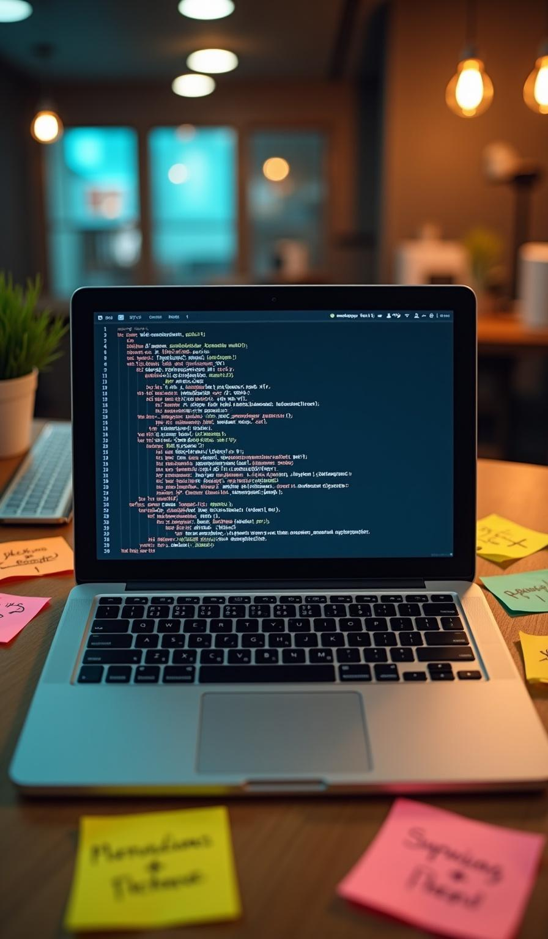
5.Part-of-Speech (POS) Tagging
Assigning word types (noun, verb, adjective, etc.). Example: 'Dogs bark loudly' → [('Dogs', Noun), ('bark', Verb), ('loudly', Adverb)] NN – Noun (Singular) VB – Verb JJ – Adjective RB – Adverb IN-Prepositions

Slide 11

6. Dependency Parsing
Analyzing grammatical structure of a sentence.
Identifies subject, object, modifiers, etc.

Slide 12

7. Named Entity Recognition (NER)
Detects entities like names, places, organizations, dates. Example: 'Apple Inc. was founded in 1976.' → [Apple Inc.: ORG, 1976: DATE] Common NER Categories: PERSON – Names of people ORG – Organizations/companies GPE – Countries, states, cities DATE – Dates/times MONEY – Monetary values

Slide 13
Chunking groups words into meaningful phrases, such as noun phrases and verb phrases, simplifying further analysis of sentence contents.
8. CHUNKING

Slide 14

Sentence: “The tall girl smiled.”
POS Tags:
The/DT (Determiner)
tall/JJ (Adjective)
girl/NN (Noun – Singular)
smiled/VBD (Verb – Past Tense)
After Chunking (Noun Phrase – NP):
[NP The tall girl] smiled
"The tall girl" is grouped as a Noun Phrase (NP)
"smiled" remains outside as a Verb

Slide 15
Chunk Label | Phrase Type | Example
NP | Noun Phrase | [The tall girl] smiled.
VP | Verb Phrase | The girl [has been running].
PP | Prepositional Phrase | The cat is [under the table].
ADJP | Adjective Phrase | She is [very smart].
ADVP | Adverb Phrase | He spoke [very clearly].

Slide 16

Additional Important NLP Steps (Often Used in Advanced NLP or Downstream Tasks):
Text Normalization
Lowercasing, removing punctuation, correcting typos.
E.g., "HELLO!!!" → "hello"
Text Vectorization / Embedding
Converting text into numerical format for machine learning.
Methods: Bag-of-Words, TF-IDF, Word2Vec, GloVe, BERT embeddings, etc.

Slide 17

Coreference Resolution
Identifying when different words refer to the same entity.
E.g., "Mary went to the store. She bought milk." → She = Mary
Sentiment Analysis
Detecting emotional tone of the text (positive, negative, neutral).

Slide 18
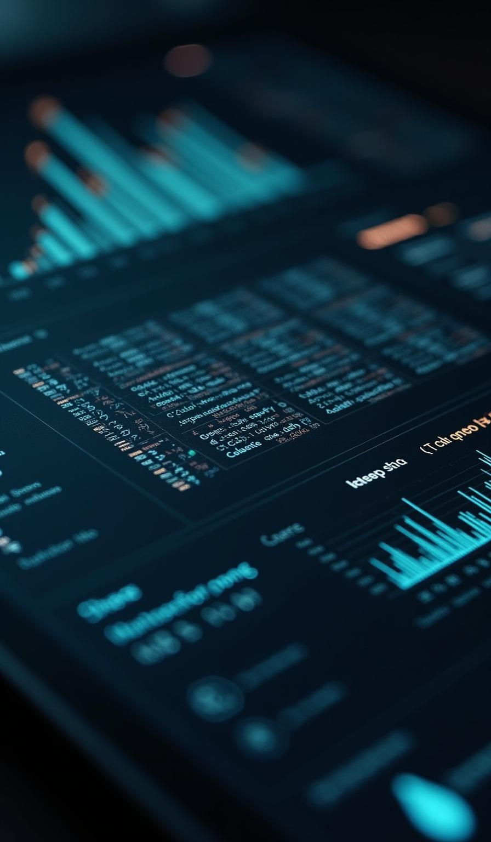
Language Detection
Identifying which language the text is in (English, Spanish, etc.).
Topic Modeling / Text Classification
Grouping or categorizing text by topics or labels.
Keyword Extraction / Keyphrase Extraction
Identifying most important words/phrases in a document.

Slide 19

THANK YOU

